Slide 1


DESIGN THINKING TOOLS APPLIED FOR AN EMERGENCY RESPONSE APP
submitted in partial fulfillment for the award of the Degree of Bachelor of Engineering
in
COMPUTER SCIENCE & ENGINEERING
by
Shivam Kumar
Shashwat Anand
Shailja Kriti
Shaurya Raj
Shreyansh Jain
1BF25CS243
1BM25CS267
1BF25CS240
1BM25CS268
1BM25CS273
Under the mentorship of
Santosh S
Assistant Professor, Department of Mechanical Engineering, BMSCE
Department of COMPUTER SCIENCE & ENGINEERING
B.M.S College of Engineering
(Autonomous College under VTU), Bengaluru- 560019

Slide 2



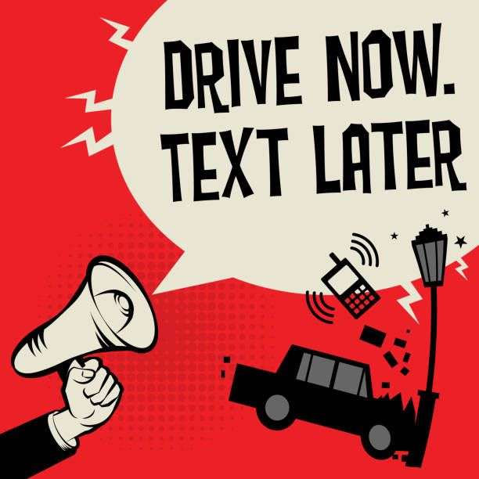
Responder-
Intelligent Personal Safety & Crash Detection System
In the fast-moving world of rush, adrenaline and rapidness, people often tend to miss on a thing that matters most to them while on the “safety”. Let’s dive into an analysis and a relative solution for the matter.

Slide 3
Empathize :Understanding the Issues
Lakhs of road accidents occur in India annually.
In severe accidents (solo crashes, late-night driving), victims are often unconscious or unable to reach their phone to dial emergency services.
The significance of “Golden Hour” plays a major role between life and death. The first hour after a traumatic injury is critical. Delayed response times drastically reduce survival rates.
Analyzing on your driving behaviors before hand may reduce the occurrence of the accidents.
And helping someone in need right after their accident can help save a lot of lives as well
People involved: 6.1L
*Numbers could be higher, these statistics
are based only upon the reported data.
Source: Ministry of Road Transport & Highways

Slide 4

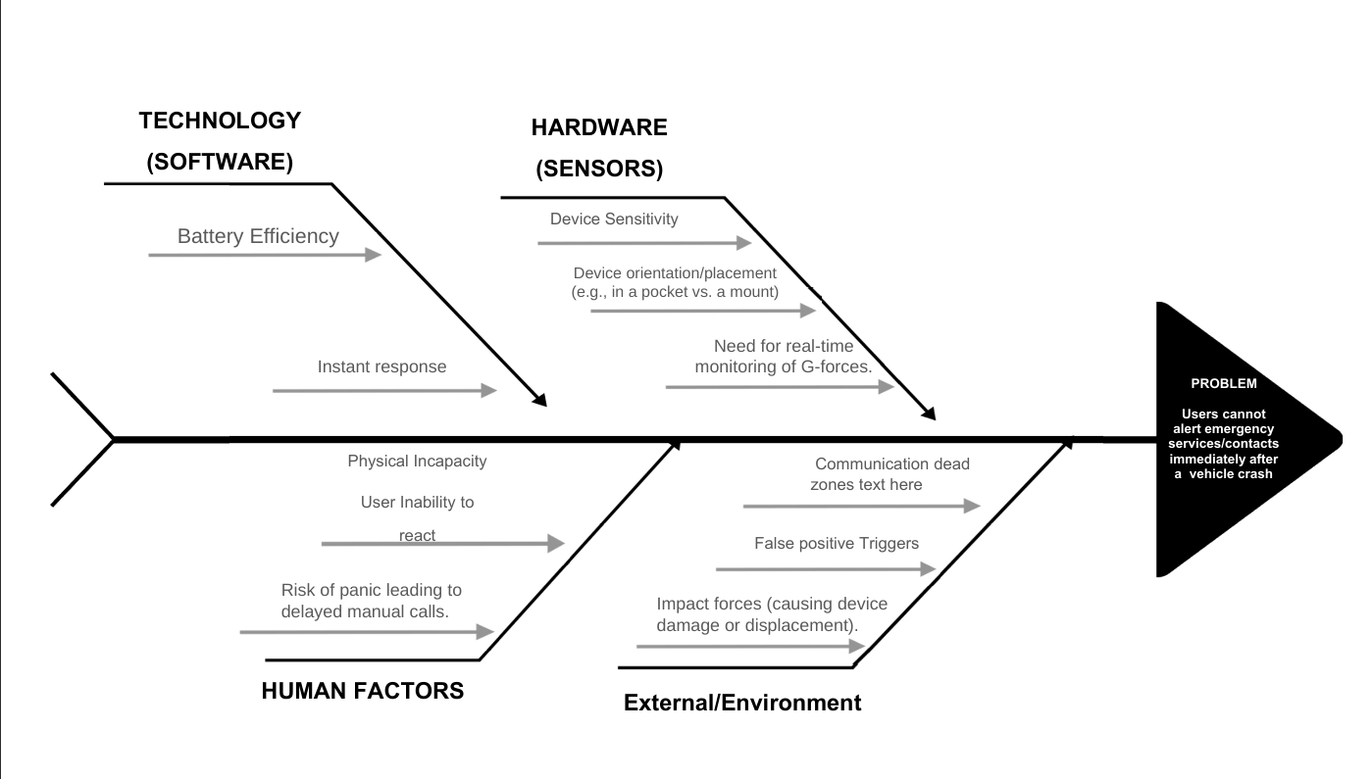
Define: The Problem
Problem Statement: Users need a way to automatically alert emergency services and emergency contacts immediately after a crash, specifically when they are physically unable to interact with their devices.

Slide 5
Ideate: brainstorming ideas
Idea: Leverage the high-fidelity sensors already present in modern Android smartphones to create a "Virtual Black Box.“
Key Features:
Crash Detection: Real-time monitoring of G-forces.
False-Positive Check: A 10-second countdown with an audible alarm before sending the SOS (allows user to cancel if safe).
SOS Transmission: Auto-sends GPS coordinates to contacts + calls emergency services (e.g. 112).

Slide 6
Hardware utilization
Android phones presently already come pre-loaded with a lot of sensors, we would just utilize the same in a effective way.
Accelerometer:
Usage: Detects sudden deceleration (High G-force spikes) indicative of an impact.
Gyroscope:
Usage: Detects violent rotation (rollovers or spinning).
Light/Proximity Sensors:
Usage: Context awareness (e.g., detecting if the phone is trapped in a deployed airbag or pocket vs. thrown clear).
Microphone:
Usage: Validating the crash via acoustic signature (glass breaking/crunching metal sounds).

Slide 7


Prototype
Software Flow
1. Monitor
2. Trigger
3. Validate
4. Action
Background service reads sensor data in low-power mode.
Algorithm detects >4G impact + Tumble + Velocity Drop.
10-second countdown alarm. User can cancel if safe.
Send SMS with Lat/Long. Auto-dial Emergency Services.

Slide 8
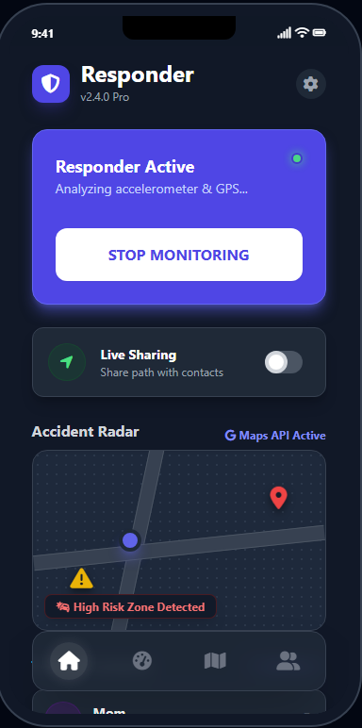
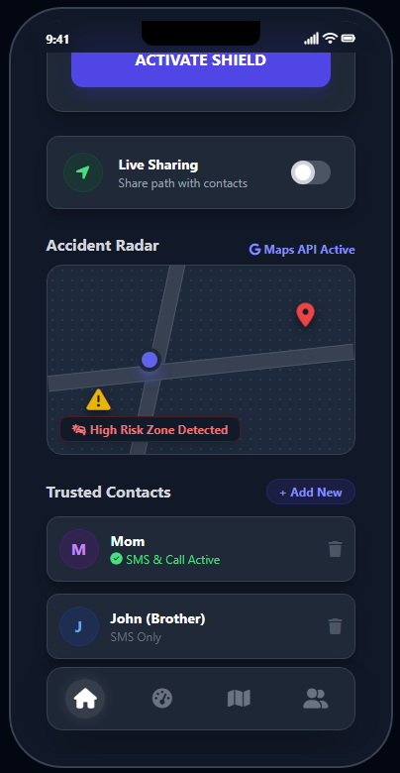
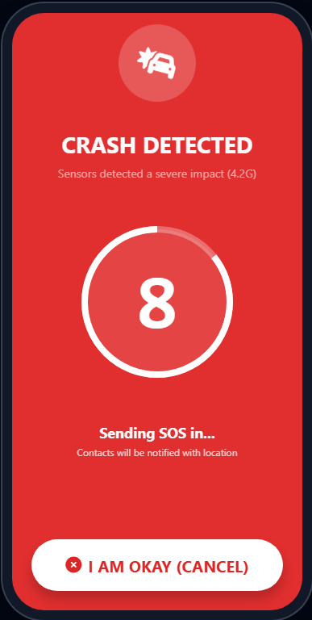
The User Interface
Home Screen: Large "Safety On" toggle button; Status indicator (Green = Monitoring).
Emergency Countdown Screen: High-contrast Red/White interface. Large "I AM OKAY" button to cancel the alarm.
Settings: Add/Edit Emergency Contacts; Adjust sensitivity levels.
Interface Preview: Responder – Dark Theme

Slide 9
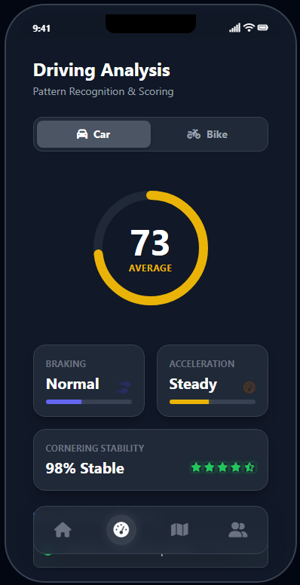
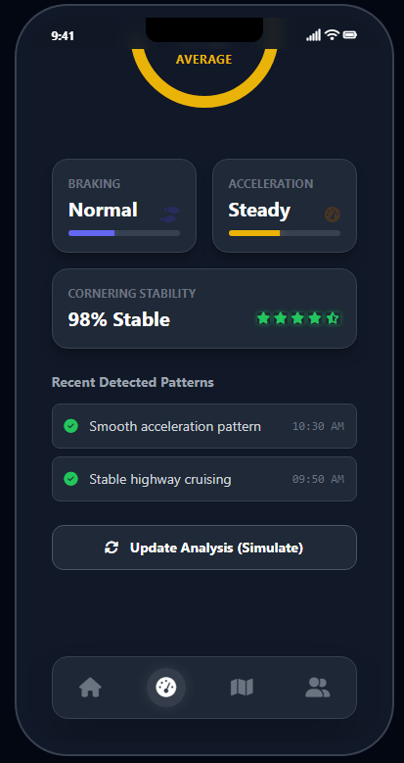
Additional Features
Driving style analysis: Tracks your driving pattern whether driving a car or a 2-wheeler and determines a certain style and tells about the fields for a safer drive.
Nearby crash report: Using Google maps API and software’s own self-crash detection database, determines nearby crashes.

Slide 10
Deployment
Phase-Wise Deployment
Phase 1: Calibration
Phase 2: Pilot
Phase 3: Launch
Phase 4: Scale
Internal Alpha Data collection from 50 devices to tune sensor sensitivity and filter out potholes vs. real impacts.
Closed Beta Rollout to 500 users in a single city. Integration test with local SMS gateways and latency checks.
Public Release Regional Android launch. Data collection from various conditions and enhancements.
Large Scale International data launch, transiting from Google Maps API to SpaceX Live Imagery.

Slide 11
Conclusion
Impact & Future Scope
Impact: Reduces emergency response time, potentially saving lives during the "Golden Hour."
Scalability: Can be integrated into ride-sharing apps (Uber/Lyft) or fleet management software.
Future Tech: Integration with car Bluetooth systems for more accurate data.

Slide 12
References
Data used in pie charts and graphs: Ministry of Road Transport & Highways, Government of India
AI Engine used for data integration and application build-up: Google Gemini
IDE used for program development: Visual Studio Code
Maps API for crash reporting: Google Maps Platform

Slide 13
Thank You

